Slide 1
School of Computing Science and Engineering
Course Code: BCSE2350 Course Name: Cryptographic Fundamental
Triple DES & IDEA

Slide 2
Outline
History
Encryption
Key Generation
Decryption
Ultimate

Slide 3
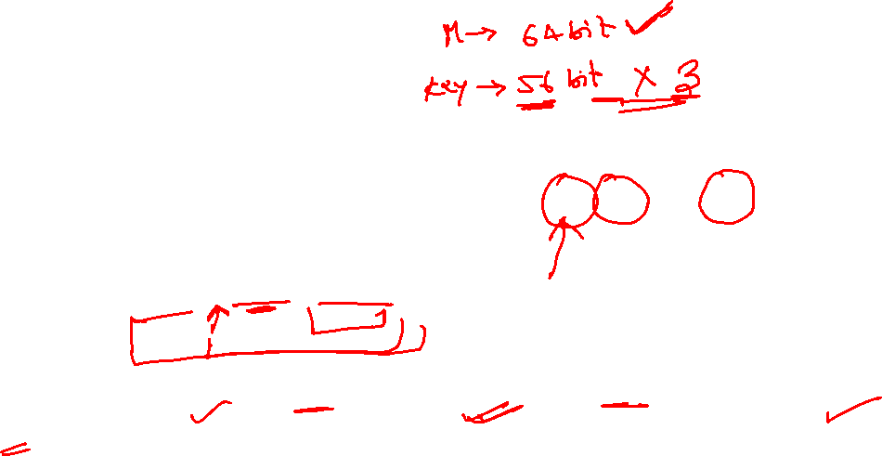
Triple DES Algorithm
Uses a block of size 64 bits.
Triple DES comprises of three DES keys, K1, K2 and K3, each of 56 bits. The encryption algorithm follows a EDE sequence:
C = E(K3, D(K2, E(K1, P)))
i.e., DES encrypt with K1, DES decrypt with K2, then DES encrypt with K3.

Slide 4
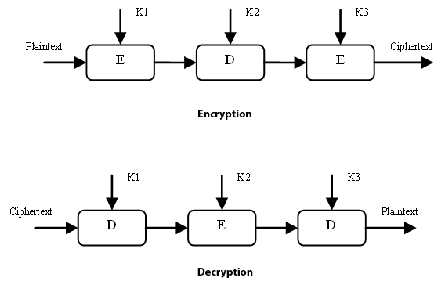
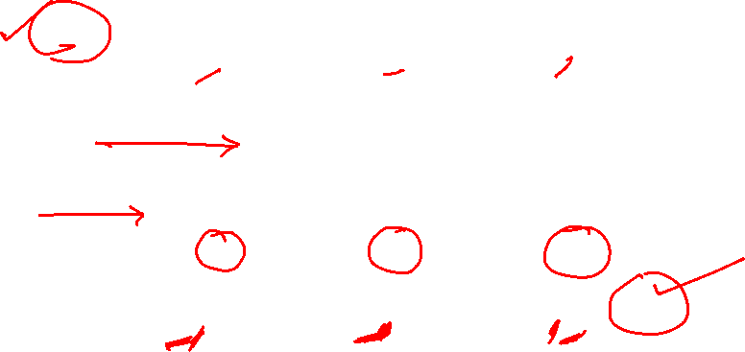
Triple DES

Slide 5
Applications
The electronic payment industry uses Triple DES and continues to develop and promulgate standards based upon it .
Microsoft OneNote and Microsoft Outlook 2007 use Triple DES to password protect user content.

Slide 6
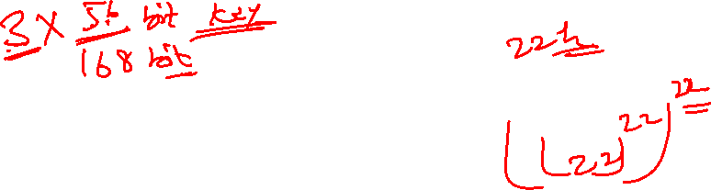
Benefits of using 3DES
With 168-bit key length, it overcomes the vulnerability to brute-force attack of DEA.
Since it is based on the DES algorithm, it is very easy to modify existing software to use Triple DES.

Slide 7
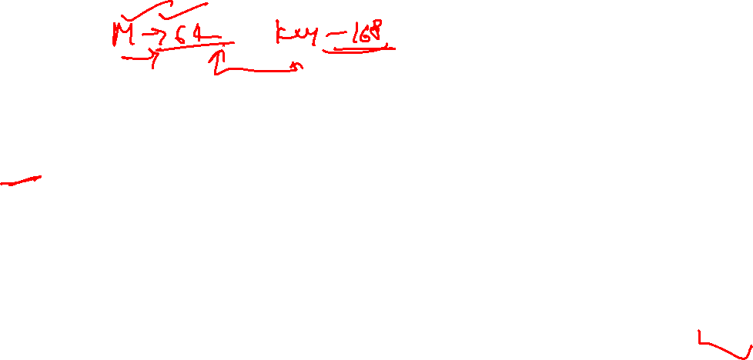
Drawbacks
It has three times as many rounds as DES, is correspondingly slower.
Uses 64-bit block size. For reasons of both efficiency and security, a larger block size is desirable.
The National Institute of Standards and Technology (NIST) issued a call for proposals to develop the Advanced Encryption Standard (AES) as a replacement for DES

Slide 8
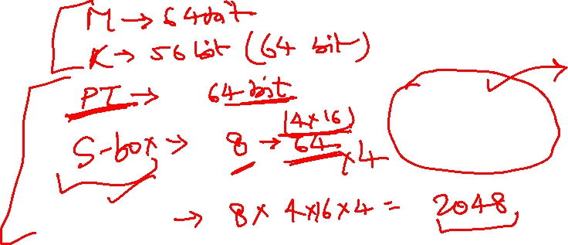
IDEA

Slide 9

History…
IDEA is a symmetric block cipher algorithm.
It was developed by Xuejia Lai and James L. Massey.
Its patents are held by the Swiss company "Ascom-Tech AG".
It was meant to be a replacement for the Data Encryption Standard.
IDEA was used in Pretty Good Privacy (PGP) v2.0 .
It is developed at ETH(Eidgenossische Technische Hochschule) in Zurich, Switzerland in 1990.

Slide 10
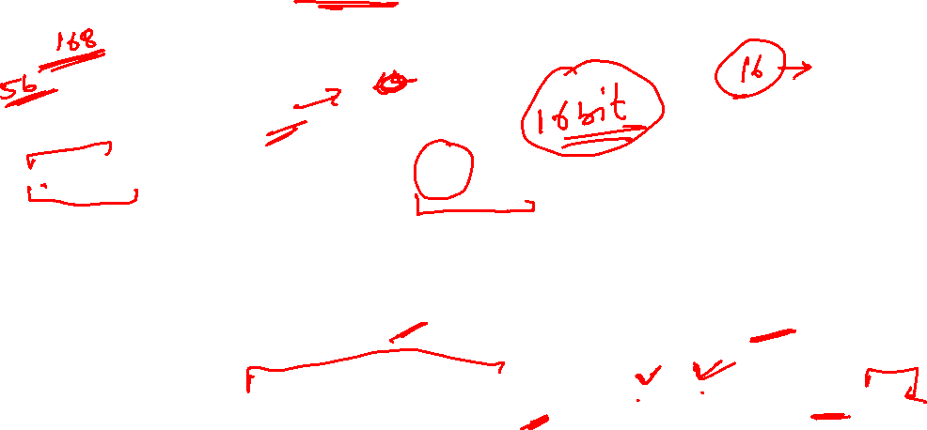
Basic idea about IDEA…
Here Plain text is of 64 bit.
Key is of 128 bit. And it is divided in 52 sub keys (how?? Thhat we will see in next slide.)
Cipher text is also as same as plain text in size that is of 64 bit.
Number of identical rounds are 8 where in each round 6 keys are used.
Like this 48 keys and in last round another 4 keys (6 * 8 = 48 + 4 =52 total) are being used in both the encryption and decryption process.

Slide 11
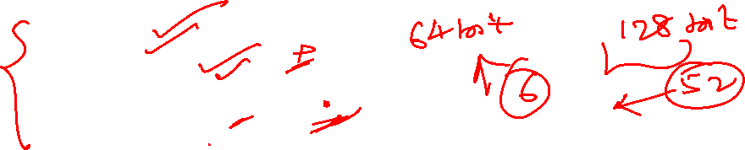
Design issue
The design philosophy behind the algorithm is one of “ mixing operation from different algebraic groups”
Lets take a look which different operations are used.
XOR
Addition
Multiplication

Slide 12

Key generation process
First of all we will see how these 52 keys are generated.
The 128 bit key is divided into 8 sub parts that is 16 bits each.
Then the 128 bit key is cyclically shifted to the left by 25 position, so by doing this we will have one new 128 bit key.
Now similarly as above it is divided into 8 sub blocks and will be used in next round.
The same process is performed 9 times ans 56 keys are generated from which the first 52keys will be used.
So likewise from K1 to K52 keys are generated.

Slide 13
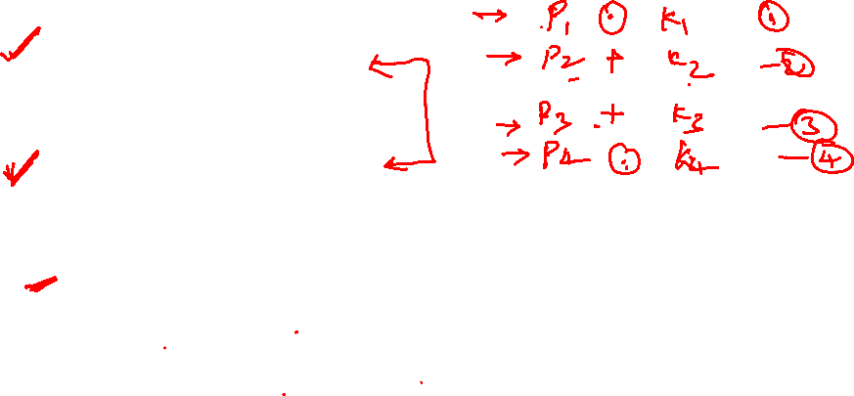
Sequence of operation in one round
Multiply P1 and K1
Add P2 and second K2
Add P3 and third K3
Multiply P4 and K4
Step 1 ⊕ step 3
Step 2 ⊕ step 4
Multiply step 5 with K5

Slide 14

Add result of step 6 and step 7
Multiply result of step 8 with K6.
Add result of step 7 and step 9.
XOR result of steps 1 and step 9.
XOR result of steps 3 and step 9.
XOR result of steps 2 and step 10.
XOR result of steps 4 and step 10.
Same operations are performed in 8 rounds…

Slide 15
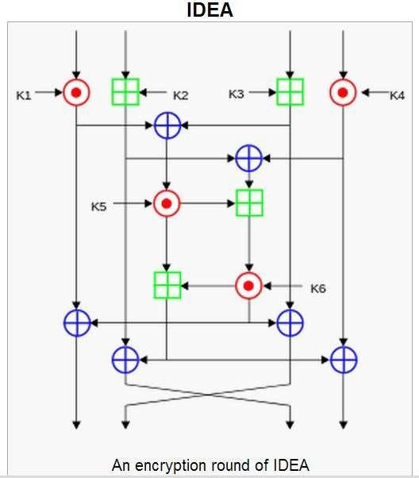
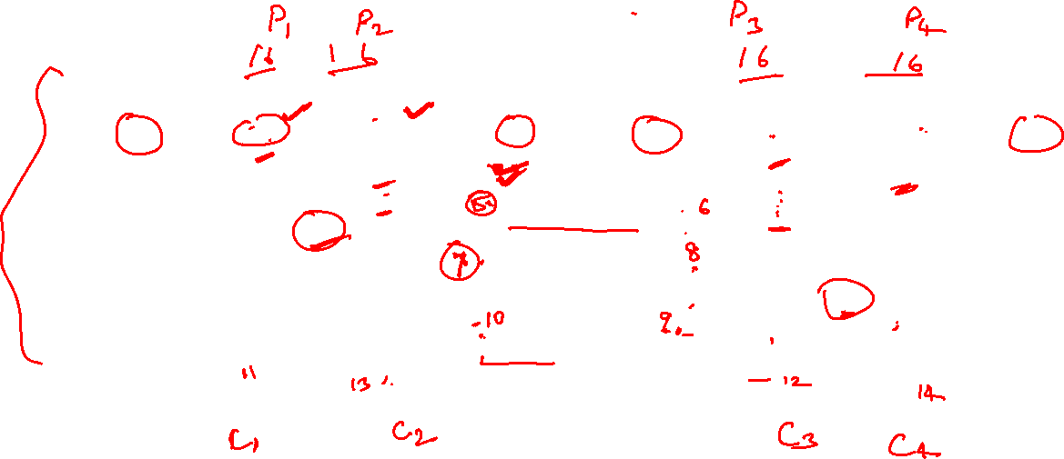

Slide 16
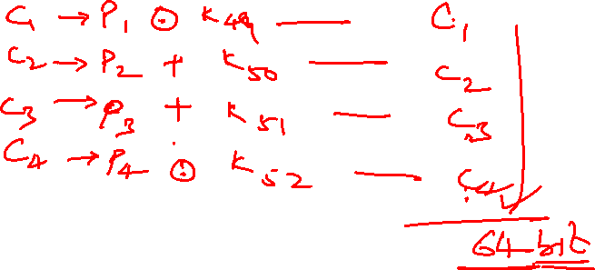
Sequence of operation in last round
Multiply P1 with K49.
Add P2 and K50.
Add P3 and K51.
Multiply P4 and K52.

Slide 17
Encryption
First of all 64 bit plain text is divided into 4 16-bit parts and they are taken as an input in first round.
At the end of the first encryption round four 16-bit values are produced which are used as input to the second encryption round
The process is repeated in each of the subsequent 8 encryption rounds
Note that in 9th round we have to use only 4 key( K49, K50, K51,K52) and have to perform different operation as guided in previous slide.

Slide 18
Decryption
The computational process used for decryption of the ciphertext is essentially the same as that used for encryption
The only difference is that each of the 52 16-bit key sub-blocks used for decryption is the inverse of the key sub-block used during encryption
Do remember that the sub blocks must be used in reverse order than of the encryption round.

Slide 19
Applications of IDEA
Today, there are hundreds of IDEA-based security solutions available in many market areas, ranging from Financial Services, and Broadcasting to Government
The IDEA algorithm can easily be combined in any encryption software.
Data encryption can be used to protect data transmission and storage.
Typical fields are:
Audio and video data for cable TV, video conferencing, distance learning
Sensitive financial and commercial data
Email via public networks
Smart cards

